Slide 1

Notes:
Alycia S. to discuss ‘River’ illustration-Then introduce Jennifer (VP of Population Health) to open

Slide 2



Where healthcare meets community.
Doing together what we cannot do apart
This project is supported by the Centers for Medicare and Medicaid Services (CMS) of the U.S. Department of Health and Human Services (HHS), Grant No. 2B2CMS331760-01-00. Contents herein are those of the author(s) and do not necessarily represent the official views of, nor an endorsement, by CMS, HHS or the U.S. Government.
Notes:
Assigned to Jennifer
Take a moment to “arrive” and be “present
Mute all mics
Sit an relax
Notice the space you are in, the chair, how it supports your body.
Notice the sounds you hear, let them drift and focus on silence.
Allow yourself to be quiet and focused on our learning session.
I invite you to ask, “Why am I here, in this learning community?” …listen for an answer; if none comes – no judgment.
Ask, “What can I do to stay focused and present to our learning session? …listen for an answer; if none comes – no judgment.
Ask, “What is my intention in doing this work, today, here, at this moment?” …listen for an answer; if none comes – no judgment.
Allow yourself to stay in the space and time; knowing the questions have been asked, some answered, and some remain for the learning to occur.
Breathe – Pause.
Slowly bring your awareness back to the space/time and take a deep breath. When you are ready – give a wave ☺

Slide 3
Agenda - This meeting will be recorded | Time
Welcoming Remarks, Review Agenda | 5 min
Embrace CT-InCK Model Driver Diagram | 20 min
Story | 5 min
Connecting Exercise - Breakout Room Report Out to Group | 20 min 15 min
Next Steps and Contact Information | 5 min
Notes:
Assigned to – Seth. Seth to introduce Alice Forrester
Transition to Introduce Bill Halsey, DSS

Slide 4

Notes:
Assigned to – Alice F. - speaks on meeting minutes- VIDEO SHOWN-Back to Alice F.
Transition to Introduce Bill Halsey, DSS

Slide 5
Driver Diagram
Notes:
Assigned to Bill Halsey, DSS (Alice will introduce Bill H. after briefly describing InCK’s Driver Diagram

Slide 6
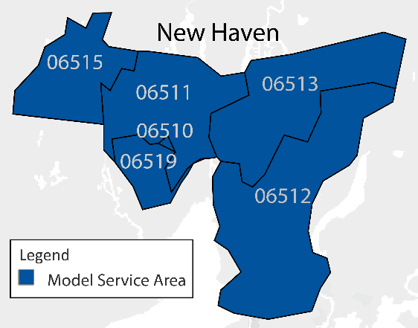
Clifford W. Beers Guidance Clinic & Connecticut Department of Social Services
Model Service Area & Population
Attributed Population: ~30K beneficiaries including 1,600+ pregnant women across 6 New Haven zip codes.
Contributors to Driver Diagram Development
CT Department of Social Services
Clifford Beers Child Guidance Center
Successful strategies and lessons learned to date:
Convening the willingness of community associates to participate in the Partnership Council to act as an advisory board comprised of all members with a vested interest in children’s welfare, a commitment to community system change
Initiating the leveraging of a collective impact of state networks and championing quality family support in effort to strengthen practices and policies embedded in clinical services and care coordination for families identified in need
Notes:
The CT Integrated Care for Kids, which we refer to as “Embrace CT InCK” is a child-centered local service delivery and state payment model intended to improve the quality of care for children, young adults under 21, and pregnant women living in New Haven, CT. Through prevention, early identification, and treatment of priority health concerns like behavioral health challenges and physical health needs, our family-centered initiative focuses on creating sustainable alternative payment models (APMs) that promote better health and social results. State agencies and local providers will share accountability for cost, savings and outcomes. Intervention through Embrace CT InCK is designed to improve child health and behavioral health access, reduce avoidable inpatient stays and out of home placement aiming to create sustainable payment models to positively impact the health of the next generation.

Slide 7
Our Model Aims and Drivers
Aim Statement
Primary Drivers
Secondary Drivers*
Measures*
Embrace CT InCK is a child-centered local service delivery and state payment model aimed at reducing expenditures and improving health equity and the quality of care for children in Medicaid and the Children’s Health Insurance Program (CHIP) through prevention, early identification, and treatment of priority behavioral health challenges and physical health needs.
Reduce Avoidable Inpatient Stays and Out of Home Placement
Implement Integrated Needs Assessment and Service Integration Level Stratification Process
Ambulatory Care: Emergency Department and Inpatient Stays
Timely access to an optimal mix of integrated health-related services
Initiation and Engagement of Alcohol and Other Drug Abuse or
Dependence Treatment
Improve Child/
Adolescent Health Outcomes
Prioritize Population Health Monitoring and Management
Well-Child Visits in the first 15 months of Life
Well-Child Visits in the first 15 months of Life
Adolescent Well-Care Visits Ages12-21
Child and Family-Centered Service Delivery
Offer Single Point of Contact for Care Coordination and Case Management
Increase Service Accessibility
Follow-up after Hospitalization for Mental Illness
Food Insecurity Assessment
Housing Stability Assessment
Kindergarten School Readiness
Create Sustainable and Accountable Care Systems for Children and Adolescents and pregnant women
Develop State-Specific Alternative Payment Models
Improve Communication and Interoperability between State/Local Systems
Notes:
Connecticut plans to address this initiative from a lens intended to help reduce health disparities by taking into account implementing a place based approach system of care. The system includes a wide community partnership made of primary care providers, New Haven Public Schools, community based organizations and integrated care coordinators just to name a few that know the unique make-up of neighborhoods in order to adequately engage all stakeholders and consider drivers of social determinants impacting overall health of children and families.
This work endorses CMS pre-established quality measures which include ambulatory care ER visits, Initiation and Engagement of Alcohol and Other Drug Abuse/Dependent Treatment as well as well-care visits intended to consider clinical performance but we also want to hone in on metrics that assess individual and community risk factors where kindergarten readiness, chronic absenteeism from school, food insecurity and housing stability are just some additional measures to consider.
We have an InCK provider advisory group as well as a member advisory group. In addition, the Behavioral Health Partnership Oversight Council (BPHOC), which is an existing legislative oversight council for Medicaid behavioral health services, will also advise the department on program and payment design, including measure alignment, as well as decision-making regarding model aims and driver support. (Is this true??)

Slide 8
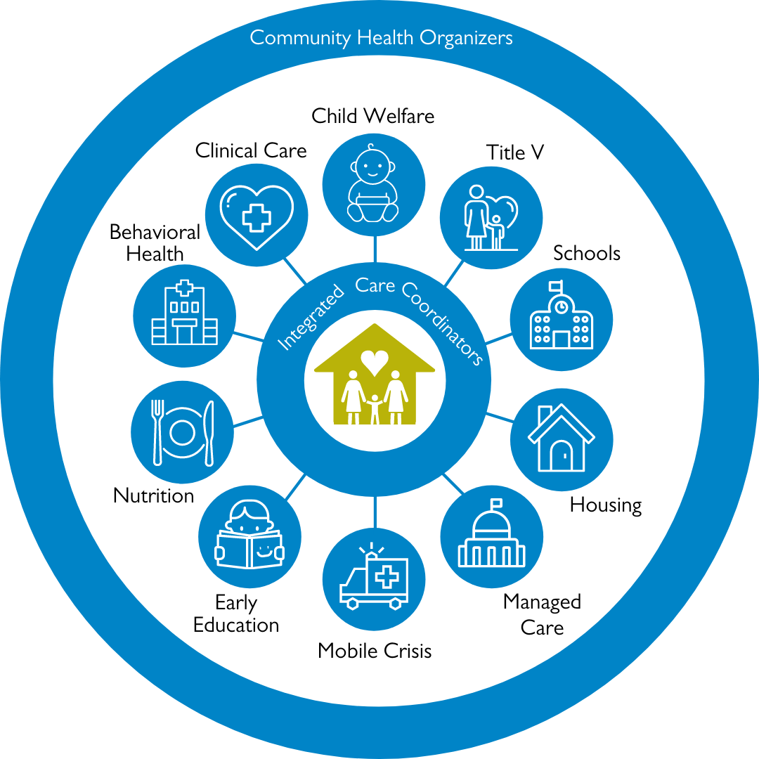
Notes:
Assigned to: Seth

Slide 9
Key Components of Our Alternative Payment Model (APM)
Type of APM
Risk Stratification
Quality Measures
Other:
Specific adjusted care coordination Per Member Per Month (PMPMs) level-based
Children and pregnant women at Level 2 & Level 3 are referred/receive care coordination services from a Medicaid enrolled InCK provider.
Service Integration Level (SIL) level of severity determined through risk stratification
Reduce avoidable hospitalizations/ER visits
Developmental and behavioral health screening in primary care, including trauma screening
Reduce referrals to DCF, juvenile justice
Reduce chronic absenteeism
Improve family well-being
Improve Housing stability
Improve Food security
Tracking of SIL movement providers
base notion of success within the system.
Notes:
All Medicaid and CHIP enrolled children who reside in New Haven, Connecticut will be analyzed through a series of analytic algorithms leveraging existing data sets and processes to identify or “risk-stratify” and establish a preliminary Service Integration Level (SIL) for severity of health risks.
Those that risk-stratify to a Level 1 will receive treatment as usual through their current Medicaid benefits and will continued to be monitored for a change in status. Those who risk stratify to a Level 2 or 3 will be eligible for a more thorough assessment by a healthcare provider and any determination of eligibility for InCK services will be referred to receive care coordination services from a Medicaid enrolled InCK provider.
In addition, our APM efforts will include examining proposed bundles that consider new or regrouped services for payment purposes, however, the adjusted care coordination payments based on levels will be the primary focus. A base PMPM is calculated for the first 18 months of the demonstration. In subsequent years, the PMPM amounts will be adjusted based on the performance metrics which are used to generate the Budget Neutral (BN) Adjustment Factors for both Level 2 & 3 for the following years. Our PMPM APM approach is not intended to cover anything but care coordination.
Transitioning all members to level 1 is not an expected outcome and the APM model is designed to not allow cherry-picking (selecting more healthier participants), however, members in level 3 represent members that have the highest needs and are at the greatest risk. It is expected that members in level 3 would require additional focus and resources to achieve the program aims.
Year over year tracking of the movement of members through the SILs will provide a base notion of success within the system. At this junction, there is no intention of evaluating the APM model, however, brainstorming around community reinvestment derived from savings from total cost of care expenditures could be used for non-Medicaid services (e.g. housing, employment and vocational services) which is something we’d like to considered as well.
Level 1: Low Risk (child and family are healthy and most social service needs are met)
Level 2: Moderate Risk (child and/or family has a healthcare condition that is likely to lead to an ED visit or hospitalization if untreated or well managed and at least one social service need is not met that may contribute to instability for the family if not addressed)
Level 3: High Risk (child and family members have a history of ED visits and/or hospitalizations and there are at least two social service needs that are not met that will contribute to family instability if not addressed)
Introduce Seth next:

Slide 10

Story of a Level Three Family
1. What do you imagine the parents/caregivers need most?
2. What resources are available and accessible in the New Haven community?
3. What is your "hopeful wish" for this family? What else does this family need that is not currently available?
Notes:
Assigned to – Seth. (Bill to introduce Seth)
Seth then to introduce Alice Corrigan
Transition to Introduce Bill Halsey, DSS

Slide 11
Connecting to
Exercise
Notes:
Assigned to: Seth (Alice to re-introduce Seth)
-Breakout rooms list of core issues
Who will Manage Breakout Rooms: CHOs
Number of Breakout Rooms: 8
At a previous PC meeting you all provided New Haven’s Greatest Hits as resources and hearing the aims/goals of driver diagram...
Specific Questions to opine on?
1. What is your "hopeful wish" for this family; beyond what is currently available?
2. What do you imagine the parent/caregiver needs most?
3. What resources are available and accessible in New Haven community?

Slide 12
Partnership Council Meeting Next Steps…
Description | Completed Date
Next Partnership Council Meetings | February 16, 2021 April 20, 2021 June 15, 2021 August 17, 2021
Website: https://www.cliffordbeers.org/embrace-new-haven-ct-inck | Password: 2021Partnership
Subcommittee Follow-up
Notes:
Assigned to: Jennifer
-Partnership Council Meeting Next Steps/Introduce the website and password info created by Hannah/Discuss how we will select and follow-up on subcommittees

Slide 13

Embrace CT-InCK Website: https://www.cliffordbeers.org/embrace-new-haven-ct-inck
Contact Information:
Shayla Ross, InCK Project Administrator
sross@cliffordbeers.org
Seth Poole, Director Systems of Care
spoole@cliffordbeers.org
Alycia Santilli, Director CARE
santillia1@southernct.edu
Jennifer Richmond, InCK Project Director
jrichmond@cliffordbeers.org
Notes:
Assigned to: Jennifer
Be sure to wish everyone a safe, healthy and Happy Holiday season!

